Slide 1

SCHOOL OF COMPUTING SCIENCE AND ENGINEERING
Program: B.Tech
Course Code: BTCS2401
Course Name: Computer Graphics
Teacher :Dr.M.Thirunavukkarasan

Slide 2

School of Computing Science and Engineering Course Code : MAIM1130 Course Name: MULTI-AGENT SYSTEMS
School of Computing Science and Engineering
Course Code : BTCS2401 Course Name:Computer Graphics
SYLLABUS
Unit-1 Fundamentals 7 hours
Types of computer graphics, Graphic Displays- Random scan displays, Raster scan displays, Frame buffer and video controller, Points and lines, Line drawing algorithms, Circle generating algorithms, Midpoint circle generating algorithm.
Unit-2 Transformations 7 hours
Basic transformation, Matrix representations and homogenous coordinates, Composite transformations, Reflections and shearing. Windowing and Clipping: Viewing pipeline, Viewing transformations, 2-D Clipping algorithms-Line clipping algorithms such as Cohen Sutherland line clipping algorithm, Liang Barsky algorithm, Line clipping against non rectangular clip windows; Polygon clipping – Sutherland Hodgeman polygon clipping, Weiler and Atherton polygon clipping, Curve clipping, Text clipping.
Unit-3 Three Dimensional 7 hours
3-D geometric primitives, 3-D Object representation, 3-D Transformation, 3-D viewing, projections, 3-D Clipping..
Unit-4 Curves and Surfaces 7 hours
Quadric surfaces, Spheres, Ellipsoid, Blobby objects, Introductory concepts of Spline, Bspline and Bezier curves and surfaces.
Unit - 5 Hidden Lines and Illumination models 7 hours
Hidden Lines and Surfaces: Back Face Detection algorithm, Depth buffer method, A-buffer method, Scan line method, basic illumination models – Ambient light, Diffuse reflection, Specular reflection ,Intensity Attenuation, Color consideration, Transparency and Shadows.
Name of the Faculty: Dr.M.Thirunavukkarasan Program Name: B.Tech

Slide 3
School of Computing Science and Engineering Course Code : MAIM1130 Course Name: MULTI-AGENT SYSTEMS
School of Computing Science and Engineering
Course Code : BTCS2401 Course Name: Computer Graphics
SYLLABUS
Unit-6 Advanced Techniques and Case Studies 3 hours
The advances and the latest trends in the course as well as the latest applications of the areas covered in the course. The latest research conducted in the areas covered in the course. Discussion of some latest papers published in IEEE transactions and ACM transactions, Web of Science and SCOPUS indexed journals as well as high impact factor conferences as well as symposiums. Discussion on some of the latest products available in the market based on the areas covered in the course and patents filed in the areas covered in the course.
TEXT BOOKS:
1. John F. Hughes, Andries Van Dam, Morgan Mc Guire ,David F. Sklar , James D. Foley, Steven K. Feiner and Kurt Akeley ,”Computer Graphics: Principles and Practice”, , 3rd Edition, Addison- Wesley Professional,2013. (UNIT I, II, III, IV). 2.Donald Hearn and Pauline Baker M, “Computer Graphics”, Prentice Hall, New Delhi, 2007 (UNIT V).
REFERENCES:
1.Donald Hearn and M. Pauline Baker, Warren Carithers,“Computer Graphics With Open GL”, 4th Edition, Pearson Education, 2010. 2.Jeffrey McConnell, “Computer Graphics: Theory into Practice”, Jones and Bartlett Publishers, 2006. 3.Hill F S Jr., “Computer Graphics”, Maxwell Macmillan” , 1990.
Name of the Faculty: Dr.M.Thirunavukkarasan Program Name: B.Tech

Slide 4

School of Computing Science and Engineering
Course Code : BTCS2401 Course Name: Computer Graphics
Course Objectives:
Students will try to learn:
1. To introduce the use of the components of a graphics system and become familiar with building approach of graphics system components and algorithms related with them.
2. To learn the basic principles of 3- dimensional computer graphics.
3. Provide an understanding of how to scan convert the basic geometrical primitives, how to transform the shapes to fit them as per the picture definition.
4. Provide an understanding of mapping from a world coordinates to device coordinates, clipping, and projections.
5. To be able to discuss the application of computer graphics concepts in the development of computer games, information visualization, and business applications.
6. To comprehend and analyze the fundamentals of animation, virtual reality, underlying technologies and principles.
Name of the Faculty: Dr.M.Thirunavukkarasan Program Name: B.Tech

Slide 5
School of Computing Science and Engineering
Course Code : BTCS2401 Course Name: Computer Graphics
COURSE OUTCOMES
Students will able to:
CO1: To list the basic concepts used in computer graphics.
CO2: Apply principles and techniques of computer graphics, e.g., the graphics pipeline, and Bresenham algorithm for speedy line and circle generation.
CO3: Apply computer graphics concepts in the development of computer games, information visualization, and business applications
CO4: To develop a facility with the relevant mathematics of computer graphics, e.g., 3D rotations are using vector algebra, geometrical transformations and projections using homogeneous co-ordinations.
CO5: Apply principles and techniques of computer graphics, e.g., the graphics pipeline, and Bresenham algorithm for speedy line and circle generation.
CO6: Understanding of latest advances and its applications in Computer Graphics
Name of the Faculty: Dr.M.Thirunavukkarasan Program Name: B.Tech

Slide 6
School of Computing Science and Engineering
Course Code : BTCS2401 Course Name: Computer Graphics
WHAT IS COMPUTER GRAPHICS
The branch of Computer Science that deals with generating images with the aid of computers is called of Computer Graphics.
(or)
Computer Graphics is the art of drawing lines, circles, pictures etc. using computer with the help of programming.
Name of the Faculty: Dr.M.Thirunavukkarasan Program Name: B.Tech

Slide 7
School of Computing Science and Engineering
Course Code : BTCS2401 Course Name: Computer Graphics
INTRODUCTION
In computer graphics, a digital differential analyzer (DDA) is hardware or software used for interpolation of variables over an interval between start and end point.
DDAs are used for rasterization of lines, triangles and polygons. They can be extended to non linear functions, such as perspective correct texture mapping, quadratic curves, and traversing voxels.
Name of the Faculty: Dr.M.Thirunavukkarasan Program Name: B.Tech

Slide 8
School of Computing Science and Engineering
Course Code : BTCS2401 Course Name: Computer Graphics
The DDA method can be implemented using floating point or integer arithmetic.
The native floating-point implementation requires one addition and one rounding operation per interpolated value (e.g. coordinate x, y , depth, color component etc.) and output result.
This process is only efficient when an FPU with fast add and rounding operation will be available.
Name of the Faculty: Dr.M.Thirunavukkarasan Program Name: B.Tech

Slide 9
School of Computing Science and Engineering
Course Code : BTCS2401 Course Name: Computer Graphics
The fixed-point integer operation requires two additions per output cycle, and in case of fractional part overflow, one additional increment and subtraction.
The probability of fractional part overflows is proportional to the ratio m of the interpolated start/end values.
DDAs are well suited for hardware implementation and can be pipelined for maximized throughput.
Name of the Faculty: Dr.M.Thirunavukkarasan Program Name: B.Tech

Slide 10
School of Computing Science and Engineering
Course Code : BTCS2401 Course Name: Computer Graphics
DDA Line Drawing Algorithm (Case a: m < 1)
x = x0 y = y0
Illuminate pixel (x,
round(y)
x = x0 + 1 y = y0 + 1 * m
Illuminate pixel (x,
rxo =un xd (+y )1) y = y + 1 * m
Illuminate pixel (x,
round(y))
Until x == x1
Name of the Faculty: Dr.M.Thirunavukkarasan Program Name: B.Tech

Slide 11
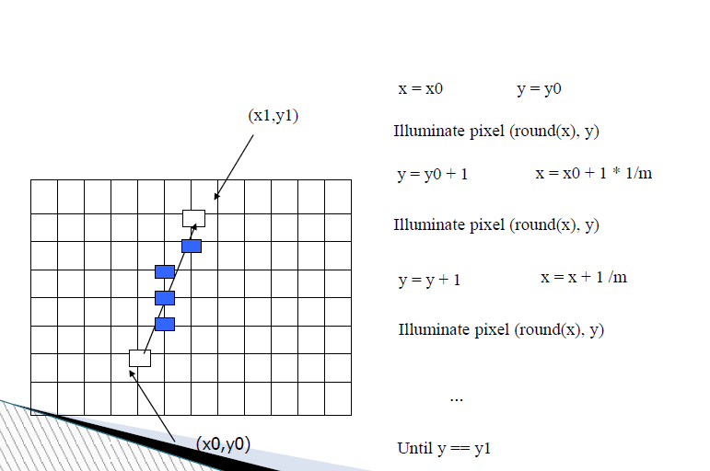
School of Computing Science and Engineering
Course Code : BTCS2401 Course Name: Computer Graphics
DDA Line Drawing Algorithm (Case b: m > 1)
Add your content here
Name of the Faculty: Dr.M.Thirunavukkarasan Program Name: B.Tech

Slide 12
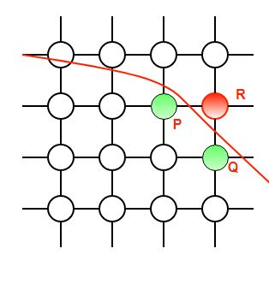
School of Computing Science and Engineering
Course Code : BTCS2401 Course Name: Computer Graphics
Use 8-fold symmetry and only compute pixel positions for the 45° sector.
Add your content here
Name of the Faculty: Dr.M.Thirunavukkarasan Program Name: B.Tech

Slide 13


